Slide 1
Operating System UNIX & Linux
Programme – T.Y.BBA(CA)
Subject title - Operating System UNIX & Linux (Revised 2017 Pattern)
Subject code-4604 Semester - VI
Unit 2-Introduction to the Kernel
Credit – 4
By
Deepali Bhoskar

Slide 2
Introduction to the Kernel
Architecture of Unix operating system
Introduction to the system concepts
Kernel data structure
System Administration

Slide 3
What is Unix ?
The Unix operating system is a set of programs that act as a link between the computer and the user.
The computer programs that allocate the system resources and coordinate all the details of the computer's internals is called the operating system or the kernel.
Users communicate with the kernel through a program known as the shell. The shell is a command line interpreter; it translates commands entered by the user and converts them into a language that is understood by the kernel.
Unix was originally developed in 1969 by a group of AT&T employees Ken Thompson, Dennis Ritchie, Douglas McIlroy, and Joe Ossanna at Bell Labs.

Slide 4
What is Unix ?
There are various Unix variants available in the market. Solaris Unix, AIX, HP Unix and BSD are a few examples. Linux is also a flavor of Unix which is freely available.
Several people can use a Unix computer at the same time; hence Unix is called a multiuser system.
A user can also run multiple programs at the same time; hence Unix is a multitasking environment.

Slide 5
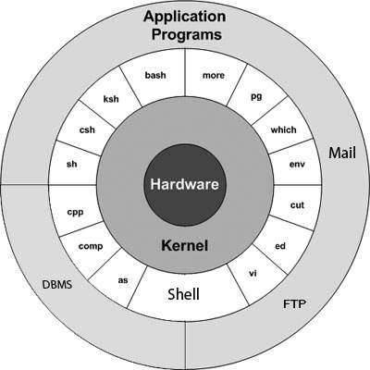
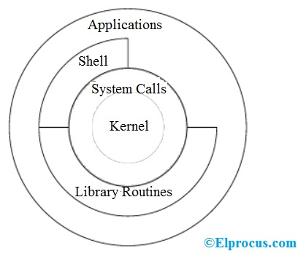
Unix Architecture
Here is a basic block diagram of a Unix system −

Slide 6
Unix Architecture
The architecture of this operating system is four layered.
It consists of Hardware, Kernel, System Call interface(shell) and application libraries/tools, utilities, etc…
The kernel controls the hardware of the computer and resides at the core of the architecture.
System calls acts as the interface between the kernel and other libraries.
These libraries include general functions and built on top of the system calls.
Shell is a special application that provides an interface to the other applications of the architecture..

Slide 7
Unix Architecture
The main concept that unites all the versions of Unix is the following four basics −
1. Kernel − The kernel is the heart of the operating system.
It interacts with the hardware and most of the tasks like memory management, task scheduling and file management.
The main functions of Kernal are-
Computer hardware such as memory, disc, printers, etc.. are controlled by the kernel.
The kernel schedules the processes, control and executes various user-defined tasks.
Manages the data storage and control the computer accesses by several users.
The kernel is composed of several sub-components such as configurations including boot code, device drivers to control hardware, header files.

Slide 8
Unix Architecture
2. Shell −
It is the interface between the user and the kernel.
Users can interact with the shell using shell commands.
Shell has two main responsibilities which include interpreting the commands given by the users and execute them using the kernel, providing programming ability to the users to write shell commands for a shell script to perform specific tasks.
The shell is the utility that processes your requests.
When you type in a command at your terminal, the shell interprets the command and calls the program that you want.
The shell uses standard syntax for all commands. C Shell, Bourne Shell and Korn Shell are the most famous shells which are available with most of the Unix variants.

Slide 9
Unix Architecture
3. Commands and Utilities −
There are various commands and utilities which you can make use of in your day to day activities.
cp, mv, cat and grep, etc. are few examples of commands and utilities.
There are over 250 standard commands plus numerous others provided through 3rd party software.
All the commands come along with various options.
4. Files and Directories − All the data of Unix is organized into files. All files are then organized into directories. These directories are further organized into a tree-like structure called the filesystem.

Slide 10
Unix Architecture
4. Files and Directories −
All the data of Unix is organized into files.
All files are then organized into directories.
These directories are further organized into a tree-like structure called the file system.

Slide 11
Introduction to the system concepts
Each computer system includes a basic set of programs called the operating system.
The most important program in the set is called the kernel.
It is loaded into RAM when the system boots and contains many critical procedures that are needed for the system to operate.
The other programs are less crucial utilities; they can provide a wide variety of interactive experiences for the user—as well as doing all the jobs the user bought the computer for—but the essential shape and capabilities of the system are determined by the kernel.
The kernel provides key facilities to everything else on the system and determines many of the characteristics of higher software.
Hence, we often use the term “operating system” as a synonym for “kernel.”

Slide 12
Introduction to the system concepts
The operating system must fulfill two main objectives:
Interact with the hardware components, servicing all low-level programmable elements included in the hardware platform.
Provide an execution environment to the applications that run on the computer system (the so-called user programs).

Slide 13
Introduction to the system concepts
Some operating systems allow all user programs to directly play with the hardware components (a typical example is MS-DOS ).
In contrast, a Unix-like operating system hides all low-level details concerning the physical organization of the computer from applications run by the user.
When a program wants to use a hardware resource, it must issue a request to the operating system.
The kernel evaluates the request and, if it chooses to grant the resource, interacts with the proper hardware components on behalf of the user program.

Slide 14
Introduction to the system concepts
To enforce this mechanism, modern operating systems rely on the availability of specific hardware features that forbid user programs to directly interact with low-level hardware components or to access arbitrary memory locations.
In particular, the hardware introduces at least two different execution modes for the CPU: a nonprivileged mode for user programs and a privileged mode for the kernel.
Unix calls these User Mode and Kernel Mode , respectively.

Slide 15
Kernel data structure
The kernel data structures play a vital role because they store data about the current state of the system.
When a new process is created in the system, a kernel data structure is created as well that stores the details about that process.
Most of the kernel data structures can be access by the kernel and its subsystems. They hold the data as well as pointers to other data structures.
Consider a user logging into the system, at that time, a new process arises and kernel stores the details about that process into the physical memory.

Slide 16
Kernel data structure
Kernel Components
The kernel stores and creates a lot of information. So it has data about which processes are running in the system, their memory requirements, files in use, etc.
Kernel data structures are maintained using three important structures. These are process table, file table and v node/ i-node information.

Slide 17
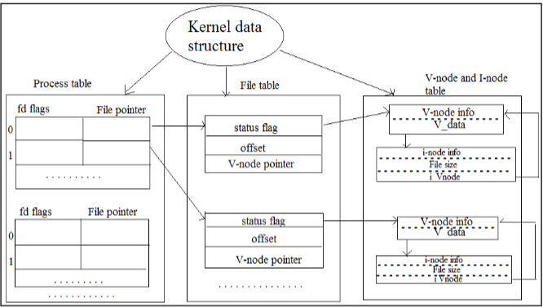
Kernel data structure
Kernel Components

Slide 18
Kernel data structure
Details about these are given below:
Process Table
The process table holds information about all the processes running in the system. It is required by the kernel. These include storage information, execution status, file information, etc. Process table also stores the other entries like -
Process state: (When a process forks a child, its entry in the process table is duplicated including the file information and file pointers. So the parent and the child process share a file.)
Process ID: It is created when a new process generated and identifies the process.
User ID: It determines the privileges to the users for the particular process.
Pointer: It is a pointer to a page table for managing the memory and also a pointer to the process area.
Timer: It is used for knowing which resource uses how much time.

Slide 19
Kernel data structure
File Table
A process table has a pointer which points to the file table.
File table holds the entries about all the files in the computer.
If multiple processes use the same file, then they contain the same file information and the file descriptor number.
Each file table entry contains information about the file such as file status (file read or file write), file offset, etc.
The file offset specifies the position for next read or write into the file.
The file table also contains v-node and i-node pointers which point to the virtual node and index node respectively. These nodes contain information on how to read a file.

Slide 20
Kernel data structure
V-Node and i-Node Tables
Both the v-node (virtual node) and i-node (index node) are related to the storage system of the file and the storage mechanisms.
The v-node is an abstract concept (in the form of the object) that describes the interaction with file data. All file manipulation like closing a file, opening a file is done by V-node object. V-node information stored in main memory.
The i-node data structure gives information about files or directory (i.e. actual representation of files or directory )
The information like the location of disk block where the file is stored, time at which file changes last, owner of the file, access permissions (read/write), etc. i-node information is stored in secondary storage.
A directory is names given to the i-nodes. A directory is in the form of parent and each of its children. List of file names and corresponding i-node number are stored in a directory entry.

Slide 21
System Administration
Systems administration is the
1) installation and
2) maintenance of the UNIX computer system.
The system administrator will need to maintain the software and hardware for the system which includes hardware configuration, software installation, reconfiguration of the kernel, and networking to keep it running in a satisfactory manner.
To do this the system administrator can assume super user or root privileges to perform many tasks not normally available to the average user of the system.

Slide 22
Absolute and Relative Pathnames in UNIX
A path is a unique location to a file or a folder in a file system of an OS.
A path to a file is a combination of / and alpha-numeric characters.
Absolute Path-name
An absolute path is defined as the specifying the location of a file or directory from the root directory(/). To write an absolute path-name:
Start at the root directory ( / ) and work down.
Write a slash ( / ) after every directory name (last one is optional)
For Example :

Slide 23
Absolute and Relative Pathnames in UNIX
For Example :
$cat abc.sql
will work only if the fie “abc.sql” exists in your current directory.
However, if this file is not present in your working directory and is present somewhere else say in /home/kt , then this command will work only if you will use it like shown below:
cat /home/kt/abc.sql
In the above example, if the first character of a pathname is /, the file’s location must be determined with respect to root. When you have more than one / in a pathname, for each such /, you have to descend one level in the file system like in the above kt is one level below home, and thus two levels below root.
An absolute path is defined as specifying the location of a file or directory from the root directory(/). In other words,we can say that an absolute path is a complete path from start of actual file system from / directory.

Slide 24
Absolute and Relative Pathnames in UNIX
Relative path
Relative path is defined as the path related to the present working directly(pwd).
It starts at your current directory and never starts with a / .
To be more specific let’s take a look on the below figure in which if we are looking for photos then absolute path for it will be provided as /home/jono/photos but assuming that we are already present in jono directory then the relative path for the same can be written as simple photos.

Slide 25
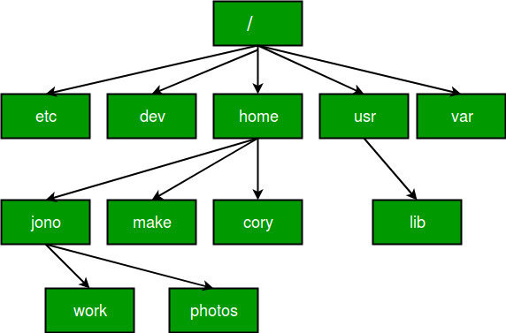
Absolute and Relative Pathnames in UNIX

Slide 26
Absolute and Relative Pathnames in UNIX
Using . and .. in Relative Path-names
UNIX offers a shortcut in the relative pathname– that uses either the current or parent directory as reference and specifies the path relative to it. A relative path-name uses one of these cryptic symbols:
.(a single dot) - this represents the current directory. ..(two dots) - this represents the parent directory.
Now, what this actually means is that if we are currently in directory /home/kt/abc and now you can use .. as an argument to cd to move to the parent directory /home/kt as :

Slide 27
Absolute and Relative Pathnames in UNIX
Example of Absolute and Relative Path
Suppose you are currently located in home/kt and you want to change your directory to home/kt/abc.
Let’s see both the absolute and relative path concepts to do this:
Changing directory with relative path concept :
$pwd /home/kt
$cd abc
$pwd /home/kt/abc
Changing directory with absolute path concept:
$pwd /home/kt
$cd /home/kt/abc
$pwd /home/kt/abc

